Slide 1
Medical device failure analysis.
AD-PRS-CAP-101126
Company presentation · Capabilities
Independent engineering for counsel, manufacturers, and healthcare organizations.
Alpha Devices Corporation · Philadelphia · October 2026 · Rev A
Notes:
The deck follows the website, section by section. Each slide stands on its own; skip to the section the audience needs.

Slide 2
What this presentation covers
00
Agenda
Twenty minutes
Audience: counsel, quality and engineering teams, clinical engineering and risk management
The same content is on alphadevices.io
01 The firm
02 Capabilities
03 Who we work with
04 Device experience
05 How we work
06 Resources and tools
07 Contact

Slide 3

The firm
01
Section 01
An independent engineering consultancy focused on medical devices, based in Philadelphia.

Slide 4
The firm
A medical device is a system of interacting parts. Understanding an incident takes more than examining a single component.
alphadevices.io/about

Slide 5
Understanding the complete system
1.1
The firm
Independent
We serve plaintiff and defense counsel, manufacturers, hospitals, and medical examiners. Opinions follow the evidence, whichever side retains us.
We examine mechanics, electronics, fluid flow, heat transfer, sensors, and software to understand how the device behaved.
  Inspections and controlled experiments test the proposed explanations.
Design and quality records show how requirements and risks were addressed.
  MAUDE reports and other FDA records put the device’s history beside the incident evidence.
We work with clients from the initial technical assessment through reporting and expert testimony.
  An engagement may involve a specific test, a documentation review, or a broader investigation.

Slide 6
Independent analysis in major litigation
1.2
Experience
$1.1B
$50M
8
Philips Respironics litigation
Other litigation supported
Device categories
Device analysis and expert-witness support in the Philips Respironics litigation, which reached a $1.1 billion U.S. personal-injury and medical-monitoring settlement. The recall covered 15 million devices worldwide (FDA).
Nearly $50 million in combined verdicts and settlements across other matters supported by Alpha Devices.
From cardiac and respiratory systems to infusion, temperature management, and patient support. See section 04.
Notes:
Our role is to establish the engineering facts and explain them clearly. Settlement source: Philips first-quarter results 2024. Recall: FDA press announcement, April 9, 2024 — the sound-abatement foam “can break down,” and “black pieces of foam, or certain chemicals that are not visible, could be breathed in”; 15 million devices worldwide.

Slide 7

Capabilities
02
Section 02
Six ways to answer the technical question. Testing, software analysis, documentation review, and FDA research each contribute to the answer.

Slide 8
Six capabilities, one question at a time
2.1
Capabilities
TABLE 01
CAPABILITY | WHAT IT ANSWERS | WHAT YOU RECEIVE
01 Failure analysis & reconstruction | Determine what failed, how it happened, and which explanations the evidence supports. | A documented assessment of the failure mechanisms, the alternatives, and the limits of the evidence
02 Custom testing & measurement | Design experiments that answer the questions the records leave open. | A focused test program with methods, measurements, results, and limitations
03 Software, firmware & device data | Connect logged events with the physical behavior of the device. | An account of system behavior and event timing, with missing or conflicting data identified
04 Design & quality documentation | Review the QMS, DHF, risk file, and traceability matrix against real-world performance. | Design decisions and risk controls assessed against test results and field experience
05 MAUDE & FDA database analysis | Place an incident in context with adverse-event reports, recalls, and regulatory history. | A history of related reports and regulatory events, with search criteria and data limits
06 Expert reports & testimony | Explain the engineering clearly in reports, demonstratives, deposition, and trial. | Expert reports, technical demonstratives, and testimony grounded in the investigation
The six capabilities on alphadevices.io/capabilities. The next three slides give the work behind each.

Slide 9
Failure analysis & reconstruction · Custom testing & measurement
2.2
Capabilities
01 Failure analysis & reconstruction
02 Custom testing & measurement
Determine what failed, how it happened, and which explanations the evidence supports.
  Mechanical, electrical, thermal, and fluid-system analysis
  Device condition, accessories, and maintenance history
  Incident reconstruction and comparative evaluation
  Assessment of both malfunction and normal operation
You receive: A documented assessment of the failure mechanisms, the alternative explanations, and the limits of the available evidence.
Design experiments that answer the questions the records leave open.
  Custom fixtures and instrumented test environments
  Sample-device and comparative testing
  Pressure, flow, temperature, and particle measurements
  Repeatable experiments built around the technical question
You receive: A focused test program with recorded methods, measurements, results, and limitations.
Notes:
We inspect the device and its components, reconstruct the relevant operating conditions, and test each proposed cause of failure. The investigation also evaluates evidence that the device operated normally.
We build test fixtures, instrument sample devices, and recreate the operating conditions that matter. The measurements show whether a proposed failure mechanism is consistent with how the device actually performs.

Slide 10
Software, firmware & device data · Design & quality documentation
2.3
Capabilities
03 Software, firmware & device data
04 Design & quality documentation
Connect logged events with the physical behavior of the device.
  Code and firmware evaluation
  Event logs, waveforms, and time alignment
  Alarm, sensor, and control-logic analysis
  Correlation of recorded events with bench testing
You receive: A documented account of system behavior and event timing, with missing or conflicting information identified.
Review the QMS, DHF, risk file, and traceability matrix against real-world performance.
  Verification and validation protocols, results, and deviations
  Complaint investigations and corrective and preventive action (CAPA)
  Warnings, instructions, design changes, and foreseeable use
  Analysis against the standards and requirements that applied at the time
You receive: An assessment of design decisions and risk controls against test results and field experience, with supporting records and open questions identified.
Notes:
We analyze code, firmware, settings, and recorded signals alongside the physical evidence. That lets us reconstruct the sequence of events and explain how the device’s sensors, alarms, and controls responded.
The technical record shows how a device was designed, which risks were recognized, and how the safeguards were tested. We trace those decisions through the design and quality documentation, identify gaps, and evaluate whether the evidence supports the conclusions in the file.

Slide 11
MAUDE & FDA database analysis · Expert reports & testimony
2.4
Capabilities
05 MAUDE & FDA database analysis
06 Expert reports & testimony
Place an incident in context with adverse-event reports, recalls, and regulatory history.
  Targeted searches by device, manufacturer, product code, and event type
  Review of event narratives, report patterns, and relevant dates
  Cross-checking related records and identifying potential duplicates
  Comparison with device testing, complaints, and design records
You receive: A history of relevant reports and regulatory events, supported by source records, search criteria, and a clear statement of the data’s limitations.
Explain the engineering clearly in reports, demonstratives, deposition, and trial.
  Early case assessment and evidence priorities
  Independent opinions and technical responses
  Discovery and deposition preparation
  Expert testimony and demonstrative development
You receive: Clear expert reports, technical demonstratives, and testimony grounded in the investigation.
Notes:
We analyze MAUDE and the other openFDA datasets to find related reports and trace a device’s regulatory history. Records are matched by product name, manufacturer, model, and device identifier so the incident can be seen in context.
We develop independent technical opinions and evaluate opposing explanations. Our reports and testimony set out the findings, the methods behind them, and the evidence supporting each conclusion.
MAUDE reports help identify questions for investigation. On their own they do not establish causation or failure rates. We account for reporting limitations and incomplete or unverified records when interpreting the findings.

Slide 12
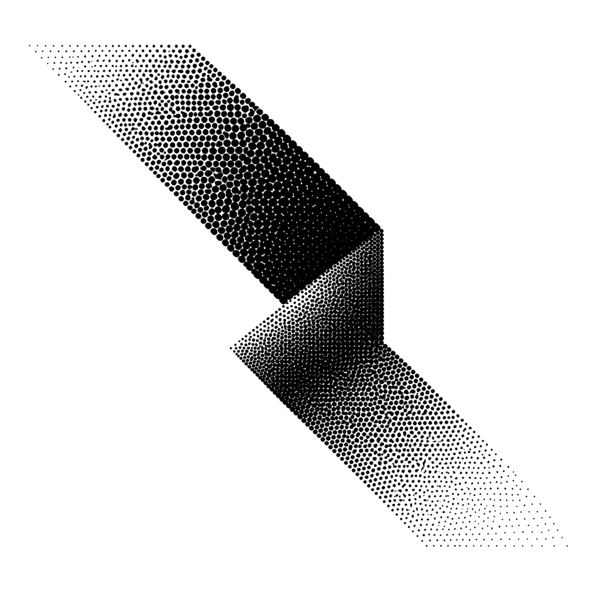
Who we work with
03
Section 03
Legal counsel, manufacturers, hospitals and health systems, and medical examiners. The question differs; the method is the same.

Slide 13
Four kinds of client, four kinds of question
3.1
Clients
TABLE 02
CLIENT | THE QUESTION | WHAT WE DO | WHAT YOU RECEIVE
Legal counsel | Understand the engineering behind the case. | – Identify inspection priorities, key design records, and evidence gaps – Reconstruct device behavior and evaluate causation theories – Connect MAUDE reports and recall history with the incident evidence | Independent analysis from early case assessment through reports, deposition, and trial.
Manufacturers | Find the cause of a device complaint. | – Investigate performance complaints and disputed failures – Review QMS records, the DHF, risk files, and requirements traceability – Evaluate complaint and recall patterns alongside test evidence | Focused testing and documented findings for engineering, quality, risk, and legal teams.
Hospitals & health systems | Establish the device’s role in an incident. | – Inspect equipment and review configuration and maintenance records – Connect device logs, alarms, and operating conditions – Identify evidence gaps and recommend further testing | An independent technical assessment to inform incident review, equipment decisions, and the response to a claim.
Coroners & medical examiners | Determine what the device did. | – Examine and document the device and its accessories – Extract and interpret device logs, alarms, and settings – Identify what the device evidence can and cannot establish | An independent engineering account of the device’s condition and recorded behavior, to inform the death investigation.
Counsel on either side of a matter, engineering and quality teams, clinical engineering and risk management, and death investigators.

Slide 14

Device experience
04
Section 04
Experience across clinical and home-care device systems. The same grounding in mechanics, electronics, software, heat transfer, and fluid flow carries across the categories.

Slide 15
Device categories and the questions that guide the work
4.1
Devices
TABLE 03
CATEGORY | DEVICES | ENGINEERING QUESTIONS
Cardiac & circulatory support | Heart-lung systems, perfusion pumps, and extracorporeal circuits. | Flow delivery, pressure, temperature, control behavior, and the interaction between pumps, sensors, and circuits.
Respiratory & sleep therapy | Ventilators, CPAP and BiPAP systems, and breathing circuits. | Pressure and flow, triggering, therapy delivery, alarm response, and materials in the breathing-gas pathway.
Surgical & procedural equipment | Powered surgical tools, energy-delivery systems, and operating-room equipment. | Mechanical performance, power and thermal behavior, accessories, protective functions, and use conditions.
Home care & portable devices | Home respiratory therapy, portable treatment, and patient-support equipment. | Settings, power interruptions, alarms, maintenance, and operation outside a controlled clinical environment.
Transplant & organ preservation | Organ transport, preservation, and perfusion systems. | How pressure, flow, temperature, and monitoring interact to maintain the intended operating conditions.
Infusion & fluid delivery | Infusion systems, syringe pumps, and fluid-management equipment. | Delivery accuracy, occlusion response, air detection, flow control, and the relationship between alarms and physical performance.
Warming & temperature management | Forced-air warming, heater-cooler systems, and circulating-fluid devices. | Heat transfer, airflow, particle transport, temperature regulation, and protective controls.
Patient support & monitoring | Hospital beds, positioning equipment, sensors, and alarm systems. | Mechanical movement, sensor behavior, alarm timing, operating configuration, and interactions with connected equipment.
Eight categories on alphadevices.io/devices. Each investigation starts from the question, not the category.

Slide 16

How we work
05
Section 05
Four steps in every engagement, and three commitments that hold throughout.

Slide 17
From the first question to the last answer
5.1
Method
01
02
03
04
Define the question
Follow the evidence
Explain the findings
Support what comes next
Clarify the technical question, review the available evidence, and agree on priorities and deadlines.
Inspect the device, review the records, and design tests that can distinguish between competing explanations.
Present the methods, results, and limitations in a clear report for counsel and technical teams.
Answer follow-up questions, evaluate opposing opinions, and present the findings in deposition and at trial.

Slide 18
Three commitments, and the requirements that applied at the time
5.2
Method
Three commitments
Standards and regulatory context
Opinions follow the evidence.
  Possible causes of failure and evidence of normal operation get the same weight. We say what is established, what is uncertain, and what more could help.
Test what the records cannot answer.
  Where the documents leave a question open, we design experiments that distinguish between explanations, and report the limitations with the results.
Explain it clearly.
  Methods and results in terms counsel, clients, and juries can follow: reports, demonstratives, deposition, trial.
The requirements that applied at the relevant time.
  IEC 60601, ISO 14971, IEC 62304, IEC 62366, and the device-specific standards, in the editions then in force.
  QMSR (21 CFR 820, incorporating ISO 13485:2016) since February 2, 2026; the former sections for earlier records.
Clearance, approval, and compliance answer different questions.
  None of them alone establishes the cause of an incident.

Slide 19
Practical guides and Claude skills, free on alphadevices.io
6.1
Resources
Fifteen practical guides
Six Claude skills for case document sets
01 A device failed. What happens next?
02 Searching MAUDE with purpose
03 Understanding waterfall design
04 Reading an ISO 14971 risk analysis
05 The manufacturer’s record
06 Using LLMs to review case documents
07 What the device recorded
08 The joint inspection
09 How a device reaches the market
10 How medical alarms work, and what the records show
11 When the software is the suspect
12 Use error and device design
13 Complaints, MDRs and CAPA
14 Recalls, corrections and other field actions
15 Building the device timeline
01 Case brief
02 Deposition summary
03 Deposition compare
04 Device timeline
05 Complaint reader
06 openFDA search
  Written instructions Claude follows on a case folder: index, extract, cite, verify. Every statement in the output can be opened and checked.
  alphadevices.io/ai
Notes:
Sixteen-page guides for legal teams: what to preserve, which records to request, how to read the evidence. Read online or download for the case file.

Slide 20
Tell us about the device.
Contact
Alpha Devices Corporation
Independent medical device engineering
Share a brief overview of the device, the question you need answered, and any deadlines. We explain how we can help and recommend the next steps.
info@alphadevices.io
alphadevices.io
2101 Brandywine Street, Suite 200, Philadelphia, PA 19130

